Slide 1
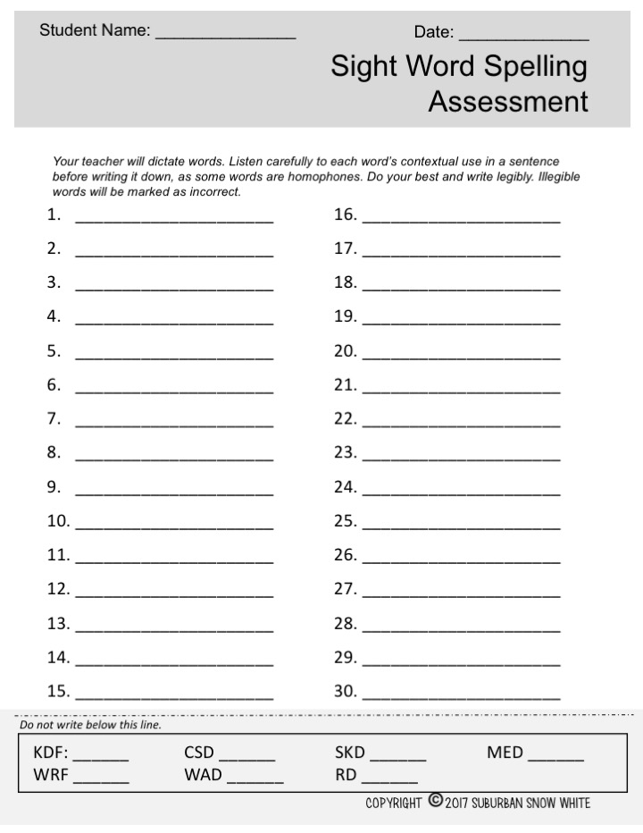
Type Your School District Name Here.

Slide 2
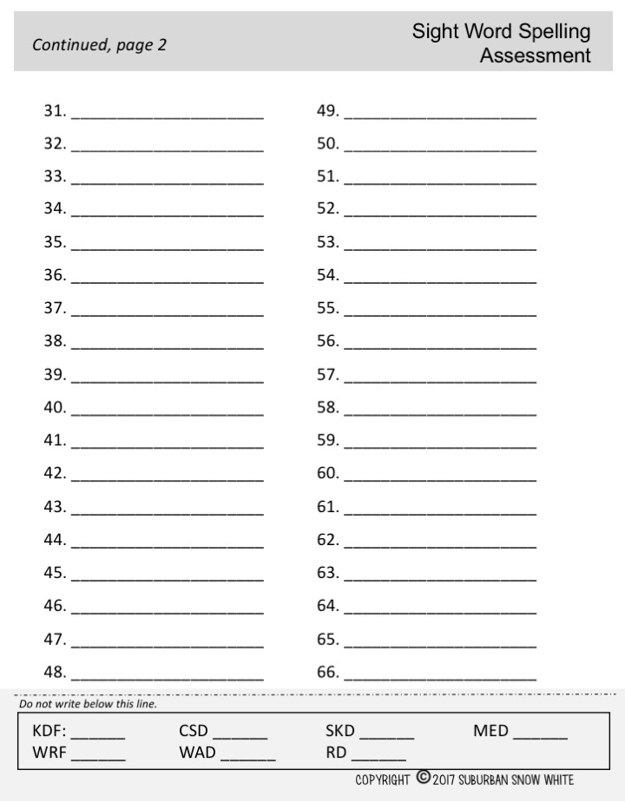
Type School District Name Here

Slide 3
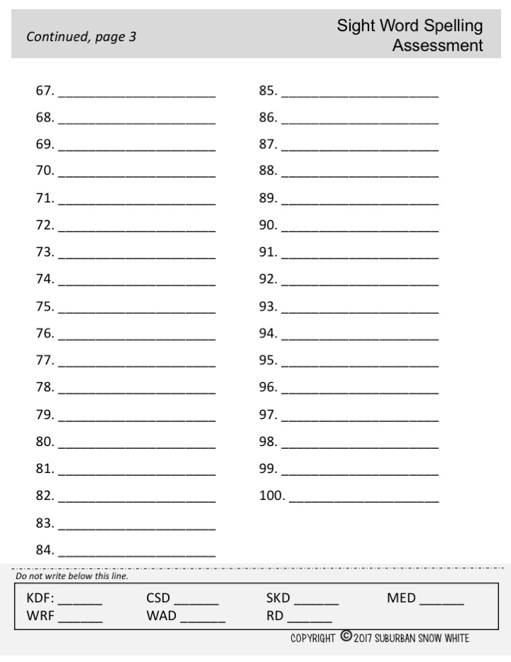
Type School District Name Here

